Slide 1

Lucky or Rigged?
Testing Fairness in Roulette with Simulation
[Team 2]
M A NABIHAN TASIN
432320005101182
MD KHAIRUL ISLAM
432320005101199
MOwMITA MOHONA
432320005101175
IRINA FERDOUS CHOITY
432320005101170
Notes:
Today we test whether a roulette wheel is fair, and whether a player can win in the long run.

Slide 2
Our Question
THE QUESTION
Is the wheel fair?
Can a player win in the long run?
Tested with a chi-square test
Tested with a t-test
Method: simulate 100,000 spins, then test: [ Chi-Square test & T-test ]
Notes:
Two questions, answered with simulation and two statistical tests.

Slide 3

How Roulette Works
THE GAME
37 pockets: 0 to 36
0 is green
Red / Black / Odd / Even pays 1 : 1
An exact number pays 35 : 1
If 0 comes up, even-money bets lose
Notes:
The green zero is where the casino advantage comes from.

Slide 4
The Game
Choose a bet, set a stake, press SPIN
Start with 1,000 virtual coins
Red
Black
Odd
Even
0 to 36
SPIN
Notes:
Live demo: run two or three spins in the notebook.

Slide 5
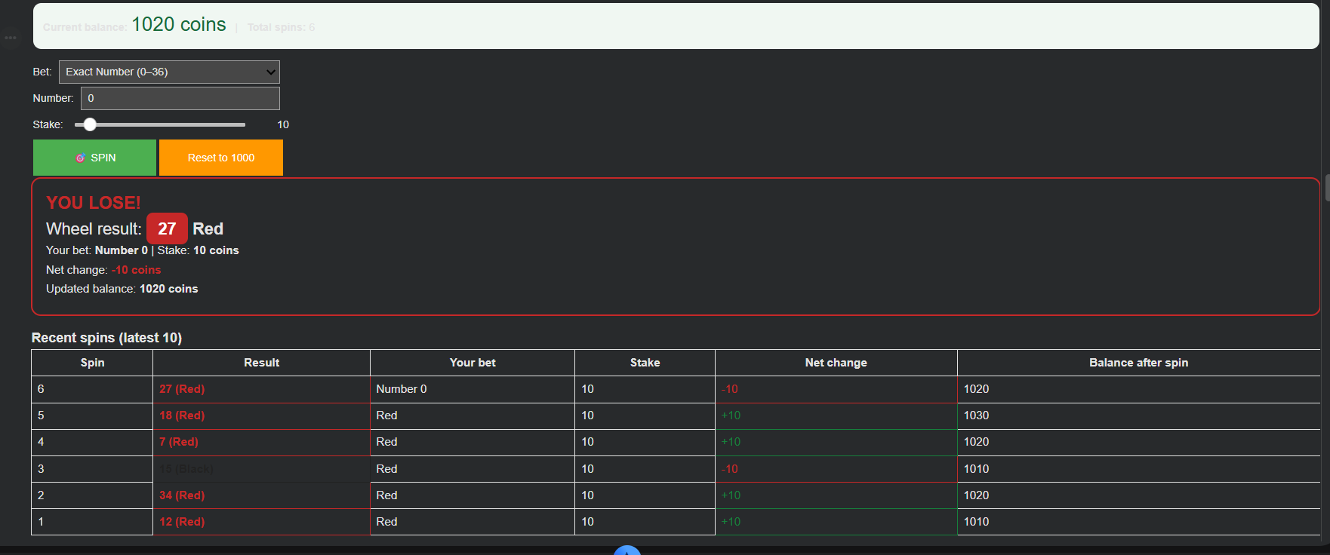
Quick Demo
Notes:
Live demo: run two or three spins in the notebook.

Slide 6
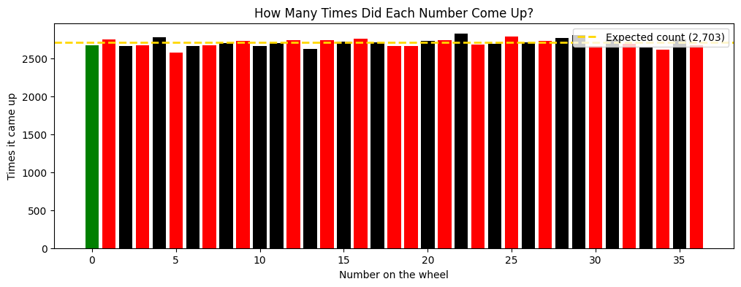
100,000 Spins
PART 1
Gold line = expected 2,703 per number. Observed 2,575 to 2,819. Mean ≈ 18, median 18.
Notes:
It looks fair, but looking fair is not proof, so we need a test.

Slide 7
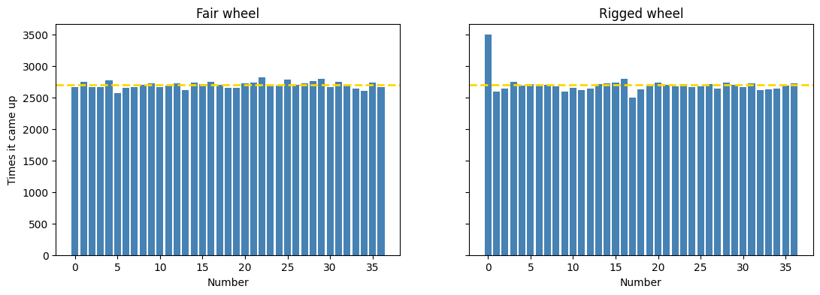
Chi-Square Test
PART 2
Fair wheel: χ² = 38.2 < 51.0. No evidence of unfairness.
Rigged (0 at 3.5%): χ² ≈ 280. Caught.
Notes:
H0: the wheel is fair, alpha 0.05. Fail to reject H0 means no evidence against fairness, not proof.

Slide 8
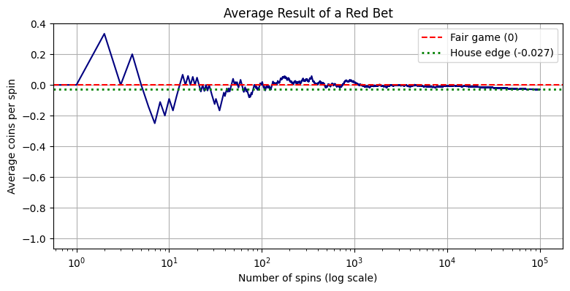
t-Test on a Red Bet
PART 3
Win chance 18/37 = 48.6%. House edge −2.7%. Average −0.030 per spin, p ≈ 10⁻²¹. Gold line = −1/37.
Notes:
Early on luck makes the average jump around, but with more spins it settles below 0.

Slide 9
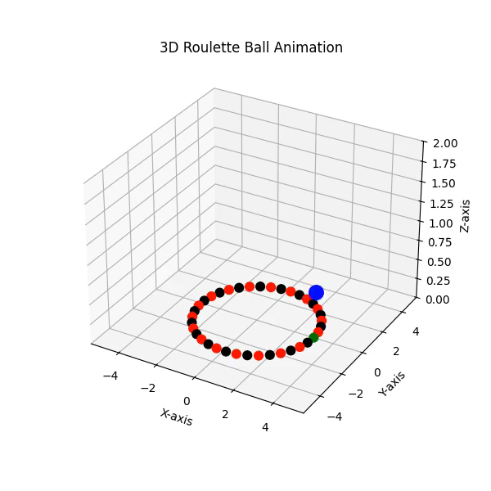
3D Animation
PART 4
The ball circles, slows down, then drops into a pocket
Real European wheel order
Built with FuncAnimation
Notes:
The animation illustrates one spin and is not part of the statistical tests. Show the animation from the notebook here.

Slide 10
Final Conclusion
SUMMARY
Is the wheel fair?
Can a player win?
No evidence of unfairness. A rigged wheel is caught.
No. About −2.7% per coin bet.
Over many spins, the casino wins. Questions?
Notes:
Thank you. Questions?

